Slide 1
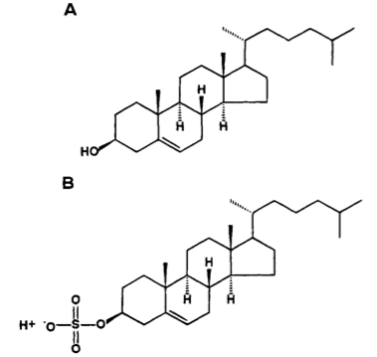
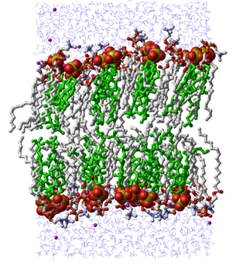
Cholesterol, Sulfate, and Heart Disease
Stephanie Seneff
Wise Traditions Workshop, London
Feb 9, 2014

Slide 2
Download These Slides
http://people.csail.mit.edu/seneff/London2014/SeneffHeartDisease2014.pptx

Slide 3
”If we all worked on the assumption that what is accepted as true is really true, there would be little hope of advance."
-- Orville Wright

Slide 4
Outline
Introduction
Cholesterol sulfate
Blood clots and hemorrhages
Streaming potential
Atherosclerosis is protective
Summary

Slide 5
Introduction

Slide 6
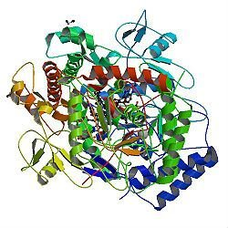
A Provocative Proposal
Cholesterol sulfate supplies oxygen, sulfur, cholesterol, energy energy and negative charge to all the tissues
Sulfate is synthesized from sulfide in skin and blood stream utilizing energy in sunlight
Protects from UV damage and keeps microbes out
Endothelial Nitric Oxide Synthase (eNOS) performs the magic
The skin is a solar powered battery!

Slide 7
High Cholesterol; Low Mortality!*
"In conclusion, our population-based study shows that high total cholesterol (TC), HDL-C, or LDL-C levels in the elderly are associated with a lower all-cause mortality compared with the group with the recommended low lipoprotein level."
"Our findings could seem controversial. However, most studies performed in older adults show an inverse association between TC and mortality [11,14]."
*L. Bathum et al., Scandinavian Journal of Primary Health Care, 2013; 31: 172–180.
Notes:
For_vic/high_cholesterol_low_mortality_2013.pdf

Slide 8
Cholesterol and Cholesterol Sulfate
Sulfation makes cholesterol water-soluble and therefore much easier to transport
SULFATE
Notes:
From cholesterol_sulfate_agile.pdf – this was the original article on that topic.

Slide 9
Think about Sulfate!
Cells in the skin produce vitamin D3 sulfate upon exposure to the sun
The precursor to vitamin D3 is cholesterol
Cells also produce an abundance of cholesterol sulfate
I believe this is the more important molecule!
Many of the alleged benefits of vitamin D3 are actually benefits of cholesterol sulfate
Protection against cancer, diabetes and cardiovascular disease; improved immune function

Slide 10
Heart Disease Mortality and Sunlight*
*Grimes et al., Q. J. Med. 1996; 89:579-589
Notes:
vitaminK/sunlight_heart_disease.pdf

Slide 11
Cholesterol and Sepsis*
"The protective role of LDL in sepsis is well documented and the increasing incidence of ICU sepsis and mortality may be linked to widespread statin use, as is also the increasing incidence of heart failure, attributed by some researchers to reduced mitochondrial coenzyme Q10 through statin inhibition."
*Do healthy people with high cholesterol need statins?
imt.ie/features-opinion/2013/12/do-healthy-people-with-high-cholesterol-need-statins.html
Notes:
./healthy_high_cholesterol_need_statins_question_mark.text

Slide 12
Lack of Sunlight May Raise Stroke Risk*
Strokes are caused by blood instability: clots and hemorrhages
Is this due to insufficient sulfate in blood?
Study involved 16,500 people
Tracked the history of where they had lived
Looked at weather statistics for those places
Found 60% increased risk to stroke for lowest sun exposure (relationship with both latitude and weather patterns)
*A. Mozes, HealthDay, RSS Feed, Feb 2, 2012.
Notes:
./sunlight_stroke_healthday.text
6,500

Slide 13
Ultraviolet Exposure and Mortality among Women in Sweden*
38,472 women selected in 1991-1992, aged 30-49
monitored for 15 years
Questionnaire asked about frequency of sunbathing vacations and sunburn
Increased sunburn frequency associated with reduced all-cause mortality
Sunbathing vacations more than once a year reduced risk to cardiovascular disease and mortality
* Yang et al., Cancer Epidemiol Biomarkers Prev. 20(4):683-690, 2011

Slide 14
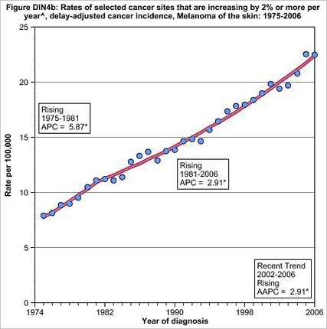
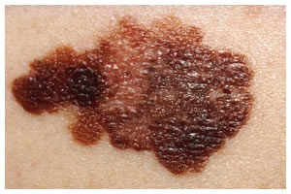
Skin Melanoma Increasing 2%/Yr since 1974*
This corresponds to a 30-fold increase in the use of sunscreen
* Andrew Schneider, Aol News, May 24, 2010
aolnews.com/2010/05/24/study-many-sunscreens-may-be-accelerating-cancer
Notes:
http://www.aolnews.com/2010/05/24/study-many-sunscreens-may-be-accelerating-cancer/

Slide 15
How to Stay Healthy
Plenty of dietary sulfur
Plenty of dietary cholesterol
Plenty of sun exposure

Slide 16
Cholesterol Sulfate

Slide 17
Cholesterol is a Miracle Worker
In the brain:
Synapse: promotes cell-cell communication
Myelin sheath: insulates channel from signal loss
In the membranes of all cells
Prevents ion leaks
Protects from pathogens (microbes)
In the plasma lipoprotein (LDL, HDL)
Essential for protecting contents from oxidation and glycation damage during transport to cells
Precursor to vital hormones
Vitamin D
All the sex hormones (testosterone, estrogen, etc.)
Cortisone: the stress hormone
Aids in digestion of fats

Slide 18
Sulfate is Vastly Underappreciated!
Sulfate is the 4th most abundant anion in the blood and protects it from coagulating
Detoxifies drugs, food additives, and environmental toxins like aluminum and mercury
Essential component of extracellular matrix proteins throughout the tissues
Cerebroside sulfate is a major constituent of myelin sheaths surrounding axons in neurons

Slide 19
Sulfated Glycosaminoglycans (GAGs)
Prominent in extracellular matrix of all cells
Amount of sulfate depends on availability
Crucial for maintaining negative charge and protecting from infection
http://www.science-autism.org/sulphate.htm

Slide 20
Sulfated Glycosaminoglycans (GAGs)
Prominent in extracellular matrix of all cells
Amount of sulfate depends on availability
Crucial for maintaining negative charge and protecting from infection
These are also known as “mucopolysaccharides”
http://www.science-autism.org/sulphate.htm

Slide 21
Ten Positive Effects of Mucopolysaccharides *
A lipid-clearing effect in the blood.
Stimulation of cellular metabolism.
Efficient metabolism of fatty acids.
Increase in RNA and DNA synthesis of cells.
Increase in growth, size and quantity of normal cells.
Anti-atherosclerosis, anti-atherogenic activities.
Anti-inflammatory effect.
Anti-thrombogenic and anti-coagulant activity.
Increases the number of coronary artery branches and collateral circulation in experimental atherosclerosis.
Accelerates healing, regeneration and repair of cardiovascular tissue
* http://www.vitaflex.com/res_csaa.php
Notes:
./mucopolysaccharides.pdf

Slide 22
Ten Positive Effects of Mucopolysaccharides *
A lipid-clearing effect in the blood.
Stimulation of cellular metabolism.
Efficient metabolism of fatty acids.
Increase in RNA and DNA synthesis of cells.
Increase in growth, size and quantity of normal cells.
Anti-atherosclerosis, anti-atherogenic activities.
Anti-inflammatory effect.
Anti-thrombogenic and anti-coagulant activity.
Increases the number of coronary artery branches and collateral circulation in experimental atherosclerosis.
Accelerates healing, regeneration and repair of cardiovascular tissue
Many of these effects can be explained by the fact that they supply sulfate
* http://www.vitaflex.com/res_csaa.php
Notes:
./mucopolysaccharides.pdf

Slide 23
Heparan Sulfate: Wonder Worker
Polymers of sugars with attached sulfates: safe glucose storage

Slide 24
Disrupted Signaling when HSPGs are Depleted*
HPGs = Heparan Sulfate Proteoglycans
*Figure 5 in P Muller and AF Schier, Developmental Cell 21, July 19, 2011, 145-158.
Notes:
Where???
Figure 5. Effective Diffusion
Interactions of signaling molecules with HSPGs. HSPGs are often associated with epithelial cell surfaces. Binding to HSPGs can alter the mobility of a signal, concentrate ligand at the surface of cells, promote or hinder ligand-receptor interactions, and influence the extracellular stability of a ligand. For example, in the absence of HSPGs, signaling molecules may not be retained on the cell surface and thereby fail to travel to the next cells.
Or Wendy/Ann/
Treasures/2011_extracellular_movement_signaling_molecules.pdf

Slide 25
HSPGs, Cholesterol and Atherosclerosis*
Reduced sulfation is associated with inflammation and atherosclerosis and with increased age
Vessels with half as much heparan sulfate have 4-5 fold more cholesterol retention
ApoE & HDL promote heparan sulfate synthesis
*L. Paca et al., J. Biol. Chem. 1999, 274:4816-4823.
Notes:
Heart/ApoE_promotes_heparan_sulfate_synthesis_endothelium.pdf

Slide 26
Are we getting enough sulfur in our diet?*
GGT = Gamma glutamyl transferase
Amino Acid Pool → Protein Synthesis
GGT
α-ketoglutarate
Urea
glycosaminoglycans
Glycosaminoglycans
*Figure 1, ME Nimni et al., Nutrition & Metabolism 2007, 4:24
Notes:
tFSeiAimignAup,slriyGfenieAt1dhGedsisiasygnratanhmdesntihist,arstotgdoernpagimcetesottfahbceoyslritesemlianteioanshgilpustabtehtiownee,npro- Simplified diagram that depicts the relationships between SAA, GAG synthesis, storage of cysteine as glutathione, pro- tein synthesis and nitrogen metabolism.

Slide 27
GGT is a Strong Predictor of …*
Arterial stiffness
Hypertension
Coronary artery disease (CAD)
Heart failure
Elevated homocysteine levels
Cardiac syndrome X: angina without CAD
Acute pulmonary embolism
*S. Jiang et al., Role of gamma-glutamyltransferase in cardiovascular diseases. Exp Clin Cardiol 2013;18(1):53-56.
Notes:
Csail/2013/project/GerryKoenig/Role_of_gamma-glutamyltransferase_in_cardiovascular_diseases.pdf

Slide 28
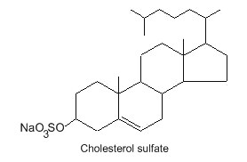
Cholesterol Sulfate: What’s It All About?*
Omnipresent in blood serum in small amounts
Collects around exterior of red blood cells (RBCs) and gives them a negative charge field
Keeps cells from sticking together or sticking to capillary walls
Prevents RBCs from falling apart
Plays an important role in barrier function in the skin
* Strott, J. Lipid Res. 44, 2003

Slide 29
Cholesterol Sulfate Protects from Obesity*
Dysregulation of glucose and lipid metabolism is a major factor in the metabolic syndrome
SULT2B1b is a sulfotransferase that synthesizes cholesterol sulfate in the liver
Induced following food consumption
Overexpression of SULT2B1b inhibits gluconeogenesis in the liver
Gluconeogenesis is the release of glucose from stored sugars which can lead to obesity
*X. Shi et al., Mol. Cell. Biol. 2014, 34(3):485.
Notes:
Heart/cholesterol_sulfate_suppresses_glycolysis_liver.pdf

Slide 30
Cholesterol Sulfate Deficiency
Cholesterol sulfate deficiency leads to filaggrin deficiency which is associated with:
Atopic Dermatitis
Eosinophilic Esophagitis
Asthma
These three conditions are on the rise and are associated with autism and celiac disease

Slide 31
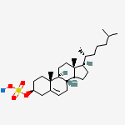
Cholesterol Sulfate Synthesis in the Skin
Keratinocytes synthesize abundant cholesterol sulfate as they mature
This synthesis takes place in the outer layer of the epidermis
Cholesterol sulfate catalyzes synthesis of profilaggrin, one of the two key proteins forming the cross-linked mesh that protects from bacterial invasion and prevents water loss

Slide 32
Water loss
Microbe penetration
Impaired wound healing in atopic dermatitis
*J.A. Segre, J Clin Invest.2006;116:1150-58
Notes:
Treasures/epidermal_barrier_formation_review.pdf
Figure 2
Figure 2
Role of barrier acquisition in the epidermal response to wound healing. Under normal conditions the epidermis serves as a barrier to retain water within the body and prevent the entry of infectious agents (e.g., microbes) or chemical agents. Den- dritic Langerhans cells, resident in the epidermis, recognize, process, and present antigens to T lymphocytes. In response to trauma to the epidermis, depicted as a full-thickness epi- dermal wound, keratinocytes increase their proliferation rate and cytokine release. Keratinocytes proliferate and migrate to re-epithelialize the wounded area. T lymphocytes are recruited into the damaged skin. As part of the normal process, kerati- nocytes initiate the process of terminal differentiation to restore the epidermal barrier. However, if the process of terminal dif- ferentiation or barrier recovery is impaired, the skin can enter an inflammatory state.

Slide 33
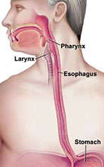
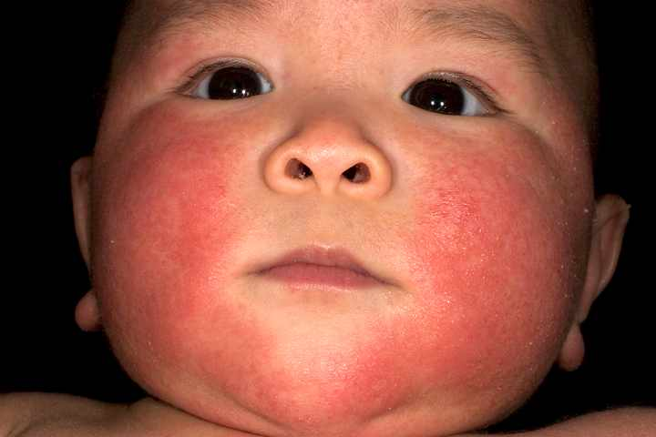
Filaggrin Plays a Crucial Role
Loss of filaggrin function associated with
Increased skin permeability
Susceptibility to eczema and asthma
Eosinophilic Esophagitis: (EoE)*
EOE is a new disease first recognized in the 1990’s
* Schroeder et al., Expert Rev clin Immunol. 6:6, 929-937, 2010.
Notes:
vitaminK/eosinophilic_esophagitis.text
http://www.medscape.com/viewarticle/731955_3
Eczema = atopic dermatitis

Slide 34
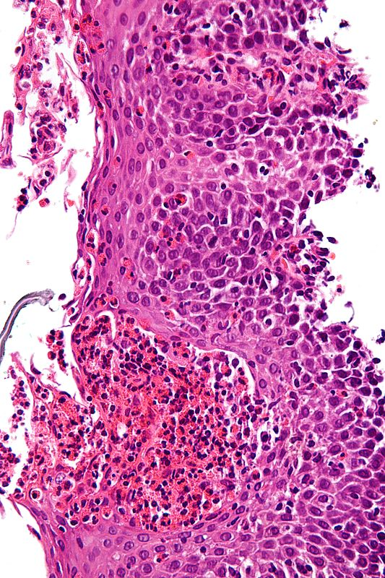
More on EoE*
Allergic inflammatory condition of the esophagus
Eosinophils invade esophagus
Release toxins that kill viruses and induce tissue damage
Person has difficulty swallowing
Eats very slowly
Food gets stuck in the throat
* Schroeder et al., Expert Rev clin Immunol. 6:6, 929-937, 2010.
Notes:
Characteristic features are present:
Abundant eosinophils - criteria vary; one common definition is: > 20 eosinophils/0.24 mm².
Papillae are elongated; papillae reach into the top 1/3 of the epithelial layer.
Basal cell hyperplasia; > 3 cells thick or >15% of epithelial thickness.
Spongiosis.

Slide 35
A Very Bad Idea

Slide 36
Cholesterol Sulfate in the Lungs*
Bronchial tubes produce cholesterol sulfate in the epithelial cells as they mature and form the outer layer of the bronchial epithelium
* Rearick et al., J. Cell. Physiol. 133:3, 573-578, Dec. 1987.
Notes:
vitaminK/lungs_bronchial_epithelium_cholesterol_sulfate.text

Slide 37
Cholesterol Sulfate in Horses’ Hoofs! *
37-43% cholesterol
15-20% cholesterol sulfate
Is Chinese medicinal use of rhino horn based on cholesterol sulfate?
*P.W. Wertz and P.T. Downing, J Lipid Res 25, 1985, 1320-1323.
Notes:
./HorsesHoof_CholesterolSulfate_1985.pdf

Slide 38
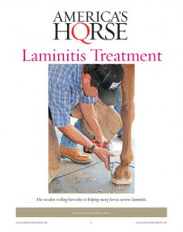
Laminitis (Founder)
Lameness in horses due to inflammation in the hoof
Can be caused by exposure to herbicides and nitrate fertilizers
Is This due to Impaired
Cholesterol Sulfate Supply to the Hoof?
Notes:
WIKI

Slide 39
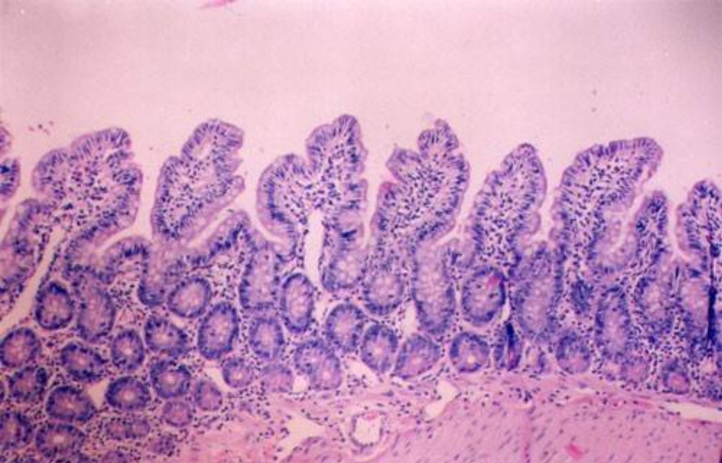
Cholesterol Sulfate and Trypsin*
Trypsin is an enzyme released by the pancreas, which digests proteins
Too much trypsin leads to breakdown of collagen glue that maintains structural integrity of intestinal mucosa (GAGs)
Cholesterol sulfate suppresses trypsin synthesis (protects mucosa from breakdown)
* Ito et al, J. Biochem. 123, 107-114, 1998.
Notes:
vitaminK/cholesterol_sulfate_inhibits_pancreatic_enzymes.pdf

Slide 40
Cholesterol Sulfate Inhibits Trypsin *
* Sato et al., J. Investigative Dermatology, 11:2, 189-193, Aug 1998
Notes:
vitaminK/cholesterol_sulfate_inhibits_trypsin.pdf

Slide 41
Recapitulation
Cholesterol sulfate plays many important roles in the body: skin, blood, esophagus, lungs, liver and gut
Cholesterol sulfate in the skin and lungs keeps bacteria out and water in
Cholesterol sulfate protects collagen from breakdown by trypsin
HSPGs play a crucial role in ion transport, nutrient uptake, and cell signaling

Slide 42
Blood Clots and Hemorrhages

Slide 43
Hemostasis
Hemostasis keeps the blood in circulation and prevents excessive blood loss upon injury
Maintained by coagulation system through clotting factors
Complex coagulation cascade involving calcium, thromboplastin, phospholipids and several serum proteins
Final product is insoluble fibrin (blood clot)
Notes:
hemCoagulation.ppt -- modified slide.

Slide 44
Hemostasis
Hemostasis keeps the blood in circulation and prevents excessive blood loss upon injury
Maintained by coagulation system through clotting factors
Complex coagulation cascade involving calcium, thromboplastin, phospholipids and several serum proteins
Final product is insoluble fibrin (blood clot)
Hypothesis: insufficient sulfate supply to blood leads to fragile state of constant tension between hemorrhage and blood clots
Notes:
hemCoagulation.ppt -- modified slide.

Slide 45
The Glycocalyx
Negatively charged gel-like mesh lining the walls of all arteries, veins and capillaries
Depends crucially on sulfated polysaccharides
Particularly heparan sulfate proteoglycans (HSPGs)
Sulfate creates “exclusion zones”
Helps protect cells in wall from ion leaks and contact with enzymes suspended in blood
Greatly reduces amount of flowing blood (decreases resistance, lowers blood pressure)
Stores energy in “battery” constructed from structured water

Slide 46
Dr. Mercola Interviews Dr. Gerald Pollack*
"The Fourth Phase of Water" = the Exclusion Zone (EZ)
Profoundly excludes things, even small molecules
H₃O₂ instead of H₂O -- negatively charged!
Fills most of your cells and the extracellular tissues
"polywater" - water as a polymer
Many experiments in our laboratory confirm the existence of EZ water
A hydrophilic surface (sulfate!) will promote growth of EZ water upon exposure to infrared light
EZ water absorbs UV light (270 nm) and this builds charge!
Water flows in small diameter tubes and the flow rate increases upon exposure to sunlight
Could the same thing be happening in your capillaries?
Pressure, oxygen, light, and infrared energy all build EZ water
*http://articles.mercola.com/sites/articles/archive/2013/08/18/exclusion-zone-water.aspx
Notes:
./GeraldPollackInterview.pdf

Slide 47
A Quote from Pollack’s Book*
“And so it is with the exclusion zone. Order cannot persist without a continual supply of energy. The separated charges will slowly recombine, and order will give way to disorder. The exclusion zone’s outer reaches will wear thin like an eroding beach.”
– page 95, The Fourth Phase of Water
Sunlight renews the exclusion zones throughout your body!

Slide 48
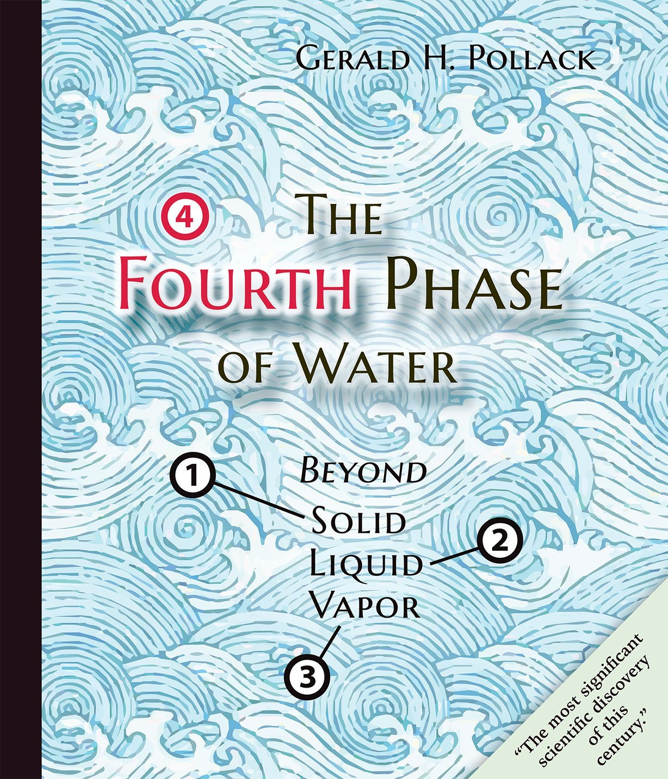
A Quote from Pollack’s Book*
“And so it is with the exclusion zone. Order cannot persist without a continual supply of energy. The separated charges will slowly recombine, and order will give way to disorder. The exclusion zone’s outer reaches will wear thin like an eroding beach.”
– page 95
Sunlight renews the exclusion zones throughout your body!

Slide 49
Therapeutic Value of Sauna Therapy (Infrared light)*
Impaired vascular function associated with hypertension, hyperlipidemia, diabetes, obesity
Sauna therapy ameliorates endothelial dysfunction and improves health
Increased eNOS synthesis in aorta in animal experiments
Decreased body weight and body fat in obese subjects
Improved cardiac function in patients with heart failure
Infrared expands exclusion zones 4-fold**
*S. Biro et al., Exp Biol Med (Maywood). 2003 Nov;228(10):1245-9.
**B. Chai et al., J Phys Chem B. 2009 October 22; 113(42): 13953–13958.

Slide 50
Effect of Radiant Energy on Near-Surface Water *
“The main question, however, is where the energy for building these charged, low-entropy zones might come from. It is shown that radiant energy profoundly expands these zones in a reversible, wavelength-dependent manner. It appears that incident radiant energy may be stored in the water as entropy loss and charge separation.”
*B. Chai et al., J Phys Chem B. 2009 October 22; 113(42): 13953–13958.
Notes:
Bob_davidson/Pollack/2009_Pollack_radiant_energy…

Slide 51
Key Role for Sulfates
Sulfates decorate exterior of cell, e.g., as heparan sulfate proteoglycans (HSPGs) or as cholesterol sulfate (Ch-S)
Sulfates carry negative charge and keep cells from sticking together
Sulfates, as kosmotropes, create exclusion zone – gel-like environment to protect cell
Red Blood Cell

Slide 52
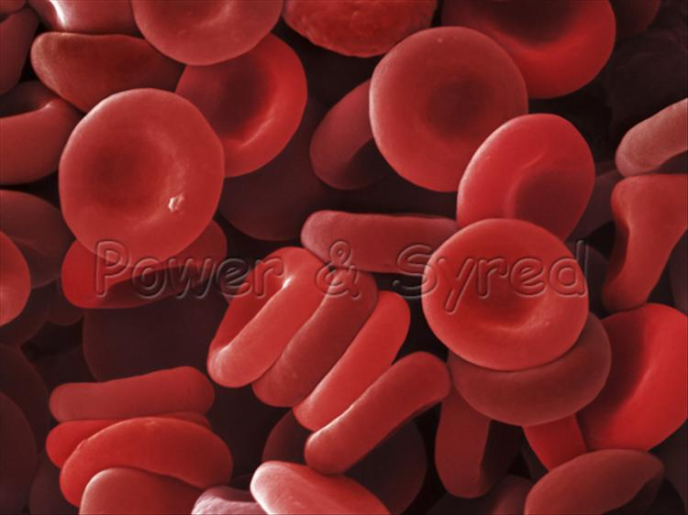
Zeta Potential
Zeta potential indicates degree of repulsion between similarly charged particles in a dispersion (e.g., the blood)
High zeta potential confers stability
RBCs and platelets resist aggregation
Low zeta potential causes flocculation and coagulation (blood clot)
Proposal: a steady drop in zeta potential in the blood as we age is the source of many modern diseases

Slide 53
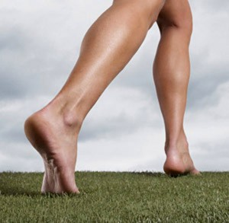
Grounding the Human Body Reduces Blood Viscosity*
Blood viscosity is strongly influenced by the surface charge on the suspended particles (like RBCs)
A higher repulsive surface charge increases spacing between RBCs, reduces clumping, lowers viscosity, and lowers peripheral resistance to flow (blood pressure)
Grounding transfers electrons from soil to the body
Increases zeta potential, lowers blood viscosity
*G. Chevalier et al., J Alternative and Complementary Medicine, 1–9, 2012

Slide 54
Negative Charge Builds on Artery Wall*
-
-
-
-
-
-
-
-
-
-
-
-
-
-
-
-
-
-
-
-
-
-
-
-
-
-
-
-
-
-
-
-
-
-
-
-
-
-
-
-
-
-
-
-
-
-
-
-
-
-
-
-
-
-
-
-
-
Red blood cells export cholesterol sulfate to the artery wall, supplying it with cholesterol, sulfate, and negative charge
* Davidson and Seneff, Entropy 14, 1399-1442, 2012.

Slide 55
A Battery!
* Davidson and Seneff, Entropy 14, 1399-1442, 2012.

Slide 56
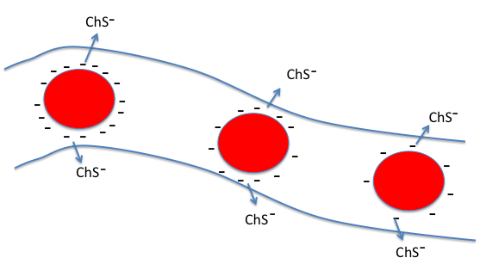
Battery Poles Between Artery and Vein
“current”
-
+
VEIN
ARTERY
RBC’s lose charge as they travel through the capillary
This sets up voltage gradient between vein and artery
Negatively charged RBC’s are propelled towards positive pole of “battery”
This creates force field that promotes blood flow
* Davidson and Seneff, Entropy 14, 1399-1442, 2012.

Slide 57
Zeta potential measures rate at which negatively charged particles travel in an electric force field

Slide 58
Hypothesis
When blood becomes deficient in negative charge (sulfates), glycocalyx becomes unhealthy
Endothelial cells develop gaps that allow blood to seep into tissues
Blood clots are needed to plug the holes
Mistakes can lead to dangerous blockage
Deep vein thrombosis
Pulmonary thrombosis

Slide 59
Strokes are Happening at Younger Age*
Incidence of stroke is increasing among people under 55 years old
959 patients followed through 2012 (aged 18 to 50 years at time of stroke)
Suffered from stroke between 1980 and 2010.
Compared with age-matched young adults without stroke
Stroke victims have higher risk of dying prematurely
3.4-fold higher risk in the 40- to 50-year-old age group
6.4 fold higher risk in the 18-29 year olds
Underlying vascular disease remains active throughout life?
*L.C. Rutten-Jacobs et al., JAMA. 2013 Mar 20;309(11):1136-44.
Notes:
./stroke_at_young_age.text

Slide 60
"High Cholesterol Levels Are Associated with Improved Long-term Survival after Acute Ischemic Stroke"*
190 stroke patients studied
Survival rates (P= 0.0001):
3-mo 1-yr 5-yr
100% 98% 84% high-cholesterol group
92% 87% 57% low-cholesterol group
*I. Markaki et al., Journal of Stroke and Cerebrovascular Diseases, 2013: 1-7.
Notes:
For_vic/high_cholesterol_protective_in_stroke.pdf

Slide 61
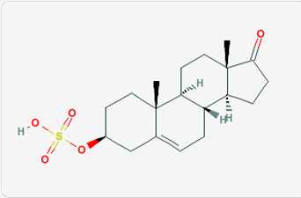
DHEA Provides Sulfate?*
In aging rats:
eNOS expression is lowered
Response of vascular smooth muscle to NO is decreased
Oxidative resistance is weakened
DHEA supplement ameliorates these effects and delays aging process
*S. Wu et al., Gerontology 2007;53:234–237.

Slide 62
Recapitulation
Hemostasis is the regulatory system that maintains blood stability
Tension between clotting and hemhorraging
Sulfates in the glycocalyx are protective
Grounding can improve blood stability by providing negative charge through currents from the ground
Red blood cells discharge negative charge by releasing cholesterol sulfate in capillaries
This helps maintain pH difference between arteries and veins to drive circulation
Strokes are happening at a younger age, and this could be related to cholesterol sulfate deficiency

Slide 63
Streaming Potential

Slide 64
Defective Streaming Potential!
I have identified impaired blood flow as the key problem in multiple modern diseases
It is a direct consequence of insufficient negative charge in the blood vessels, due to insufficient supply of sulfate anions
Zeta potential is a measure of the flow rate of charged particles (e.g., red blood cells) in an electric field
The blood’s zeta potential is an indicator of general health
MIT Computer Science and Artificial Intelligence Laboratory

Slide 65
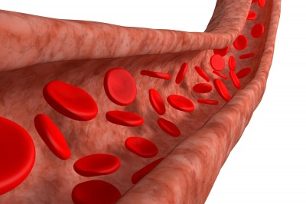
Electrokinetic Vascular Streaming Potential (EVSP)*
+
Field strength is proportional to the zeta potential → promotes blood flow
Contains a DC component and an AC component (very low frequency, depends on pulse rate and heart rate)
Influences endothelial cells:
Enhances release of nitric oxide (vasorelaxant)
Increases calcium-based depolarization
-
-
*D.P. Trivedi et al., Bioelectromagnetics 34:22-30, 2013.
MIT Computer Science and Artificial Intelligence Laboratory
Notes:
Treasures/electric_fields_induced_by_blood_flow_modulate_nitric_oxide.pdf

Slide 66
Streaming Potential
Streaming potential
Notes:
Treasures/Darshan_electrovascular_streaming_potential_endothelium.pdf

Slide 67
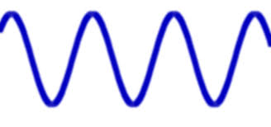
Streaming Potential
Contains both DC and AC component
AC component controlled by heart rate
Higher heart rate induces stronger response
Streaming potential
Notes:
Treasures/Darshan_electrovascular_streaming_potential_endothelium.pdf

Slide 68
Streaming Potential
Notes:
Treasures/Darshan_electrovascular_streaming_potential_endothelium.pdf

Slide 69
Streaming Potential
Proportional to Zeta potential
Notes:
Treasures/Darshan_electrovascular_streaming_potential_endothelium.pdf

Slide 70
Streaming Potential
Proportional to blood pressure
Notes:
Treasures/Darshan_electrovascular_streaming_potential_endothelium.pdf

Slide 71
Streaming Potential
Inversely proportional to viscosity
Notes:
Treasures/Darshan_electrovascular_streaming_potential_endothelium.pdf

Slide 72
Some Insights
When zeta potential is too low (not enough bound sulfate), blood pressure must go up to compensate (high blood pressure)
When viscosity is too high, blood pressure must go up to compensate (high blood pressure)
Nitric oxide is produced in response to calcium entry, which is induced by the streaming potential

Slide 73
Nitric oxide quickly converts to nitrite which can attack the glycocalyx, releasing sulfated GAGs
These can be passed on to the capillaries to correct their deficiencies

Slide 74
Excessive calcium entry leads to artery calcification
Much better solution is to maintain the capillary supply by delivering cholesterol sulfate from RBCs!!

Slide 75
WIKI on Biopterin*
"Biopterin is a cofactor in the production of many needed neurotransmitters in the body. A few of these include dopamine, serotonin and epinepherine. It is also key in the body's production of nitric oxide. … Though mainly in the pineal gland, it is also known to be produced in many other glands as well."
*induced by statin drugs!!
MIT Computer Science and Artificial Intelligence Laboratory

Slide 76
An Essential Role for Nitric Oxide
Oxygen
Nitrite oxidase
Oxygen
Nitric oxide
Nitrite
Nitrate
Breaks down
Sulfated sugars
Relaxes vessel
Lowers blood viscosity
These are normally refurbished through sulfate supplied by cholesterol sulfate and many other sulfated sterols and sulfated neurotransmitters

Slide 77
An Essential Role for Nitric Oxide
Upregulated by biopterin
Oxygen
Nitrite oxidase
Oxygen
Nitric oxide
Nitrite
Nitrate
Nitric oxide
Breaks down
Sulfated sugars
Downregulated by statin drugs
Relaxes vessel
Lowers blood viscosity
Upregulated by biopterin
These are normally refurbished through sulfate supplied by cholesterol sulfate and many other sulfated sterols and sulfated neurotransmitters
These are normally refurbished through sulfate supplied by cholesterol sulfate and many other sulfated sterols and sulfated neurotransmitters
These are normally refurbished through sulfate supplied by cholesterol sulfate and many other sulfated sterols and sulfated neurotransmitters

Slide 78
An Essential Role for Nitric Oxide
Upregulated by biopterin
Because statins downregulate cholesterol, they have to upregulate nitric oxide (to shred the glycocalyx) and neurotransmitters (to supply an alternative mode of sulfate transport)
Oxygen
Nitrite oxidase
Oxygen
Nitric oxide
Nitrite
Nitrate
Nitric oxide
Breaks down
Sulfated sugars
Downregulated by statin drugs
Relaxes vessel
Lowers blood viscosity
Upregulated by biopterin
These are normally refurbished through sulfate supplied by cholesterol sulfate and many other sulfated sterols and sulfated neurotransmitters
These are normally refurbished through sulfate supplied by cholesterol sulfate and many other sulfated sterols and sulfated neurotransmitters
These are normally refurbished through sulfate supplied by cholesterol sulfate and many other sulfated sterols and sulfated neurotransmitters

Slide 79
Nitric Oxide Degrades Extracellular Matrix*
Hyaluronan is a very long sugar chain that has only carbonates; no sulfates
Peroxynitrite is produced by a reaction between nitric oxide and superoxide
* Figure from RE Vilar et al., Biochem. J. (1997) 324, 473–479.

Slide 80
Recapitulation
Streaming potential is an electrical field created by flowing blood –vessel walls respond to the signal it creates by releasing nitric oxide
It depends on critical parameters: viscosity, blood pressure, zeta potential
When zeta potential is low or viscosity is high, blood pressure must go up to compensate
Nitric oxide can break down heparan sulfate and redistribute it – more is needed when cholesterol sulfate is in short supply (i.e., with statin therapy)

Slide 81
Atherosclerosis is Protective!

Slide 82
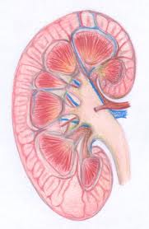
End Stage Kidney Disease and Cardiovascular Disease*
Dialysis patients have extreme risk
to cardiovascular disease
High serum cholesterol
High blood pressure
High serum homocysteine
Obesity
Inflammation
Abnormally low
homocysteine
Abnormally low blood pressure
Abnormally low cholesterol
Emaciated
* Kalantar-Zadeh et al., American Journal of Kidney Diseases 42:5 864-881, 2003
Notes:
Cancer/malnutrition_inflammation_dialysis_review.pdf
Because MICS leads to a low body mass index, hypocholesterolemia, hypocreatininemia, and hypohomocysteinemia, a “reverse epidemiology” of cardiovascular risks can occur in dialysis patients.
However, it’s also associated with IL-6, inflammation and muscle wasting, i..e,
A switch to nitrogen-based oxygen transport!!
Low serum albumin suggests low zeta potential

Slide 83
My Conclusion from This
Inflammation is the ONLY “Risk Factor” that counts:
All the other “Risk Factors” are protective measures!

Slide 84
Frustration in Treating Cardiovascular Disease for Dialysis Patients*
"Reducing mortality from cardiovascular disease among patients undergoing dialysis is a global public health challenge. The past 10 years have seen trials of many interventions designed to improve survival and cardiovascular outcomes in these patients. Unfortunately, none of these interventions have been shown to be effective, despite beneficial effects in surrogate markers. It appears that statins have now joined this group of 'promising but ineffective' interventions."
*Strippoli and Craig, N Engl J Med 2009; 360:1455-1457.
Notes:
For_vic/nothing_works_dialysis_heart_problems.text

Slide 85
Diabetes Progression*
Glyphosate!!
Loss of Beta Cells to produce insulin
Blood Pressure UP
Atherosclerosis UP
Kidney Failure
*JJ Kenney, Diet to Prevent and Reverse Insulin Resistance and Type 2 Diabetes
http://foodandhealth.com/cpecourses/insulin.php
Notes:
Heart/diabetes_insulin_resistance_prevention_practical_guide.pdf

Slide 86
Sulfates in the Kidneys*
Glucose
Glutamine
*K.-I. Nagai et al., Proc Jpn Acad Ser B Phys Biol Sci. 2008 January; 84(1): 24–29
Notes:
AnthonySamsel/celiac/sulfolipids_kidney_function_LukeMilano.pdf
Working hypothetical metabolic fate of glycolytic (glucose) and gluconeogenic (glutamine) substrates on biosynthesis of renal tubular sulfolipids. Cer-h, ceramide with hydroxy fatty acids; GalCer-h, galactosylceramide with hydroxy fatty acids; Glc, glucose; Glc 1-p, glucose 1-phosphate; Glc 6-p, glucose 6-phosphate; Gln, glutamine. Symbol, , with dashed arrows indicates comparatively inactive pathway in the isolated renal proximal tubules from well-fed rat. Sulfated lipids are indicated by hatching.

Slide 87
Statins and Kidney Failure*
Kidney failure is alarmingly on the rise in the US and elsewhere
associated with a 23-fold increase in risk to heart disease!
Statins are being overprescribed for patients with kidney failure
Severe muscle pain & rhabdomyolysis
Increased risk to dementia and diabetes
No improvement in kidney function
* M.A. Lanaspa et al., Nature Communications, 2013; Aug 24. [Epub ahead of print]
Notes:
For_vic/statins_bad_end_stage_kidney_disease.text

Slide 88
Heart Disease: A Theory!
Cardiovascular plaque develops as an alternative mechanism to produce cholesterol sulfate from damaged LDL and homocysteine

Slide 89
A Recent Paper
S. Seneff, A. Lauritzen, R. Davidson, and L. Lentz-Marino.
“Is Endothelial Nitric Oxide Synthase a Moonlighting Protein Whose Day Job is Cholesterol Sulfate Synthesis? Implications for Cholesterol Transport, Diabetes and Cardiovascular Disease.”
Entropy 2012, 14, 2492-2530.

Slide 90
What Happens when Cholesterol Sulfate Synthesis is Impaired??
Cardiovascular disease!!!
Activities in Plaque Produce Cholesterol Sulfate to Supply the Heart

Slide 91
They Knew a Long Time Ago*
Article published in 1960
Fed cholesterol to monkeys
induced atherosclerosis
If sulfur-containing nutrients are added, atherosclerosis is prevented
These nutrients provide source of sulfate to enable cholesterol transport
* G.V. Mann et al., Am. J. Clin. Nutr. 8, 491-497, 1960.
Notes:
./ monkeys_sulfur_solves_cholesterol_problem_1960

Slide 92
They Knew a Long Time Ago*
Article published in 1960
Fed cholesterol to monkeys
induced atherosclerosis
If sulfur-containing nutrients are added, atherosclerosis is prevented
These nutrients provide source of sulfate to enable cholesterol transport
"A form of vascular disease resembling human atherosclerosis has been produced in the New World primate Cebus fatuella. ... In order to produce these phenomena, the diets had to be rich in cholesterol, choline and neutral fat but relatively low in organic sulfur compounds. Without this deprivation of organic sulfur the response of the serum lipids to cholesterol feeding was small."
* G.V. Mann et al., Am. J. Clin. Nutr. 8, 491-497, 1960.

Slide 93
Steps in Atherosclerosis*
Inflamed endothelium provides adhesion molecules to trap and hold macrophages
Macrophages take up oxidized LDL and become foam cells
Smooth muscle cells proliferate (artery thickening)
Extracellular matrix proteins are degraded
Vulnerable plaque eruption: thrombosis
* Libby et al., Circulation 105:1135-1143, 2002
Notes:
Libby –
.cancer/libby_inflammation_heart_disease.pdf

Slide 94
Many Good Reasons for ROS
ROS (reactive oxygen species) are a key component of inflammation in the artery
ROS are needed to produce sulfate *
Oxidation of glycated LDL makes it accessible to macrophages for breakdown**
Peroxynitrite (product of reaction between superoxide and nitric oxide) is toxic to pathogens***
* Mitsuhashi et al. Shock 24(6) 529-34, 2005.
** Kaplan and Aviram, Arterioscler Thromb Vasc Biol 21(3) 386-93 2001.
*** Alvarez et al., J. Biol. Chem. 286, 6627-6640, 2011.
Notes:
Vitamink/peroxynitrite_fights_infetion.text
vitaminK/ROS_h2s_to_sulfite_shock_2005.text

Slide 95
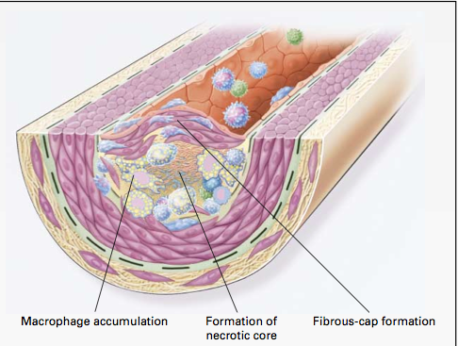
Macrophages and Cholesterol*
Macrophages in artery wall take up oxidized LDL and export extracted cholesterol to HDL-A1
Unsaturated fatty acids interfere with export process
Macrophages eventually become damaged by exposure to oxidizing and glycating agents → necrotic core
* Wang and Oram, J. Biol. Chem. 277 (7) , 5692–5697, 2002
Notes:
Results showed that unsaturated fatty acids markedly inhibited ABCA1-mediated cholesterol and phospholipid efflux from macrophages when ABCA1 was induced by a cAMP analog. This was accompanied by a reduction in the membrane content of ABCA1 and a decrease in apoA-I binding to whole cells and to ABCA1. In contrast, saturated fatty acids had no effect on these processes.
vitaminK/unsaturated_fatty_acids_inhibit_cholesterol_efflux_from_macrophages.pdf
vitaminK/unsaturated_fatty_acids_inhibit_cholesterol_efflux_from_macrophages.pdf

Slide 96
Quote from the Abstract*
“These findings raise the possibility that an in- creased supply of unsaturated fatty acids in the artery wall promotes atherogenesis by impairing the ABCA1 cholesterol secretory pathway in macrophages.”
* Wang and Oram, J. Biol. Chem. 277 (7) , 5692–5697, 2002

Slide 97
Macrophage Proliferation in Plaque*
*Figure 4, C.S. Robbins et al., Nature Medicine, Aug. 2013
[ePub ahead of print]
Notes:
Heart/macrophages_proliferate_in_plaque_2013.pdf

Slide 98
Declaring War on Macrophages*
Macrophages replicate inside plaque
Suppressing their entry into plaque is not enough!
Proposal: develop new therapy that suppresses proliferation of macrophages in plaque
"It's a bit like killing off the army to be sure there's no collateral damage when invaders attack your country”
--David Diamond, Member of THINCS
*C.S. Robbins et al., Nature Medicine, Aug. 2013 [ePub ahead of print]
Notes:
For_vic/idiocy_suppressing_macrophages_for_heart_disease.text

Slide 99
Elevated Homocysteine and Heart Disease*
587 patients with coronary artery disease followed over median period of 4.6 years
Homocysteine > 15 micromol/Liter → 6.5-fold increase in death rate compared to homocysteine < 10 micromol/L
*P.O. Lim et al., Journal of Human Hypertension (2002) 16, 411–415.
Notes:
In celiac/celiac_disease_hypertension.pdf

Slide 100
Pathway from Homocysteine to Sulfate*
When folate and B12 are deficient, nearly all homocysteine is converted to homocysteine thiolactone
homocysteine thiolactone
Vitamin A
thioretinamide
Superoxide:
Reactive oxygen species
(ROS)
Vitamin C
sulfite
alpha keto butyrate
retinoic acid
Sulfite oxidase
PAPS
Sulfated GAG
*McCully, Annals of Clinical and Laboratory Science 41:4, 300-313, 2011
sulfate
Notes:
Spacedoc/McCully/ChemicalPathologyHomocysteineV_McCully.pdf
Figure 1. Hypothetical scheme for synthesis of thioretinamide, oxidation to sulfite and sulfate, and activation of sulfate to phosphoadenosine phosphosulfate, explains sulfation of glycosaminoglycans (GAG) to form sulfate esters [2]. In this scheme superoxide is synthesized from the heme oxygenase group of cystathionine synthase [34], catalyzing retinoic acid synthesis from retinol. Synthesis of thioretinamide from retinoic acid and homocysteine thiolactone is catalyzed by cystathionine synthase and dehydroascorbate.
is hydro- lyzed to Hcy by a calcium-dependent Hcy thiolactonase (HTase) tightly associated with HDL in serum (Jakubowski 1999a). !!
When methionine synthase activity is inhibited by folate or vitamin B-12 deprivation, almost all Hcy is converted to thiolactone.
!

Slide 101
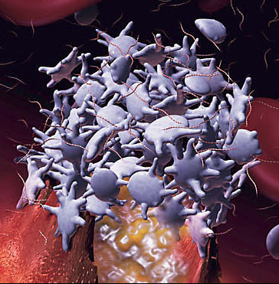
Platelets and Cholesterol Sulfate*
Platelets and RBCs both synthesize cholesterol sulfate (Ch-S)
Ch-S is present in the atherosclerotic lesions in the aorta
Platelets will accept cholesterol only from HDL-A1
Platelet synthesis rate increases 300-fold when PAPS is available.
PAPS is formed from ATP and sulfate
Platelet aggregation leads to thrombosis
HDL suppresses aggregation; LDL promotes it
* Yanai et al, Circulation 109, 92-96, 2004

Slide 102
Putting it All Together
homocysteine
Heart muscle cell
Synthesize sulfate
sulfate
ATP
PAPS
Lipid Raft
Red Blood Cell
Cholesterol Sulfate
RBC
insulin
Platelet
glucose
(3)
HDL-A1
macrophage
Ch
Ch
Artery Wall
oxLDL
LDL
ApoE
ROS
Inflammatory Agents
Endothelial Cell

Slide 103
Brits Love Statins*
Eight million Britons now take statins compared to five million a decade ago.
Top prescriber of anti-cholesterol drugs in Europe
One in five who take statins suffer side effects including muscle pain, memory disturbance, cataracts and diabetes.
*Daniel Martin, MailOnLine
dailymail.co.uk/health/article-2529283/
UK-statins-capital-Europe-With-1-8-taking-
cholesterol-busting-drugs-used-replacement-healthier-living.html
Notes:
Second only to Australia

Slide 104
Statins Increase Plaque Calcification*
6673 people studied (2413 on statins 4260 not on statins)
Mean age 59, 55% male
Evaluated using coronary CT angiography - noninvasive method to visualize atherosclerotic features
Statin use was associated with increased prevalence of calcified plaque and increasing numbers of coronary segments possessing calcified plaque
*R. Nakazato et al. Atherosclerosis 225(1), 148-153, November 2012.
Notes:
For_vic/statins_increase_calcified_plaque.text

Slide 105
“Heart Stents Still Overused, Experts Say”*
Two misconceptions
Heart attack caused by blocked artery
Eating fatty foods induces fat build-up
Heart attack is actually caused by thrombus formation (blood clot) that often occurs in a region of the artery where plaque is not obstructive
Stent insertion is expensive and is not living up to the promise of protection
*Anahad O’Connor, NY Times, Aug. 16, 2013
Notes:
./heart_stents_overused_Victor.pdf

Slide 106
I hypothesize that treatments aimed at reducing the supply of cholesterol to the plaque will eventually lead to severe deficiencies in cholesterol and sulfate supply to the heart, resulting in heart failure.

Slide 107
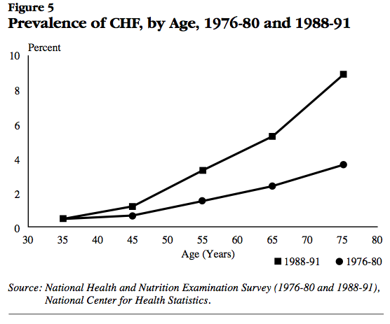
Post-statins
Pre-statins
National Heart, Lung, and Blood Institute National Institutes of Health Data Fact Sheet
Notes:
http://library.thinkquest.org/27533/facts.html
./heart_failure_stats_1990s.pdf

Slide 108
Recapitulation
Kidney disease is associated with inversion of factors for heart disease risk
Kidneys depend critically on sulfates for function
Inflammation is required to synthesize sulfate
Cardiovascular disease can be best characterized as a factory to supply cholesterol and sulfate to the heart (and kidney)
Statin drugs, through their ability to deplete the supply of cholesterol to the plaque, can lead to heart failure and kidney failure down the road

Slide 109
Summary
Sunlight-catalyzed cholesterol sulfate synthesis in the skin is essential for long-term health
Heart disease is a compensatory mechanism to synthesize cholesterol sulfate
Hemostasis depends on adequate sulfate in the blood
High blood pressure and high heart rate compensate for low zeta potential
Heparan sulfate proteoglycans (HSPGs) are pervasive in the body, and sulfate depletion leads to diabetes, heart disease, and kidney disease
I predict that statin drugs, by depleting cholesterol sulfate supplies, can lead to heart failure

